Slide 1
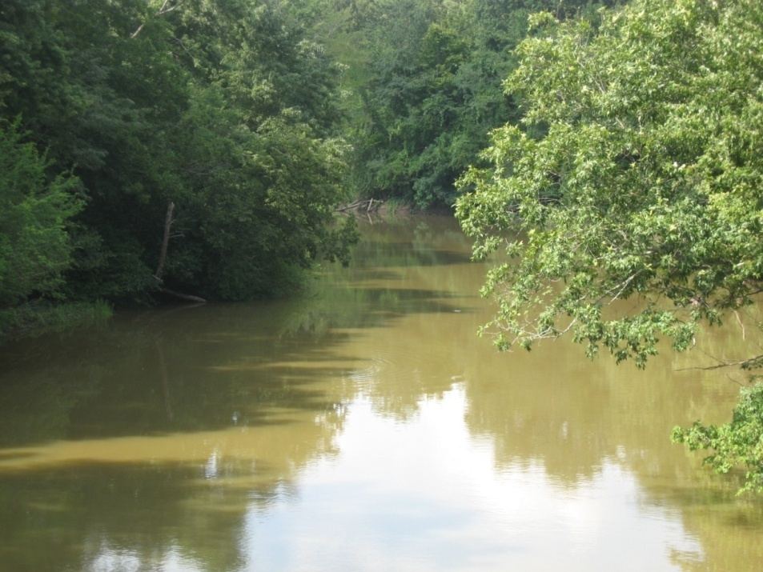

L'Anguille River Riparian Modeling
2010 Non-Point Source Project Review Meeting
Dharmendra Saraswat
Naresh Pai
Biological and Agricultural Engineering
Cooperative Extension Service

Slide 2
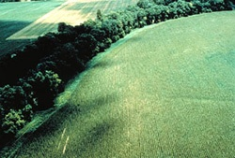
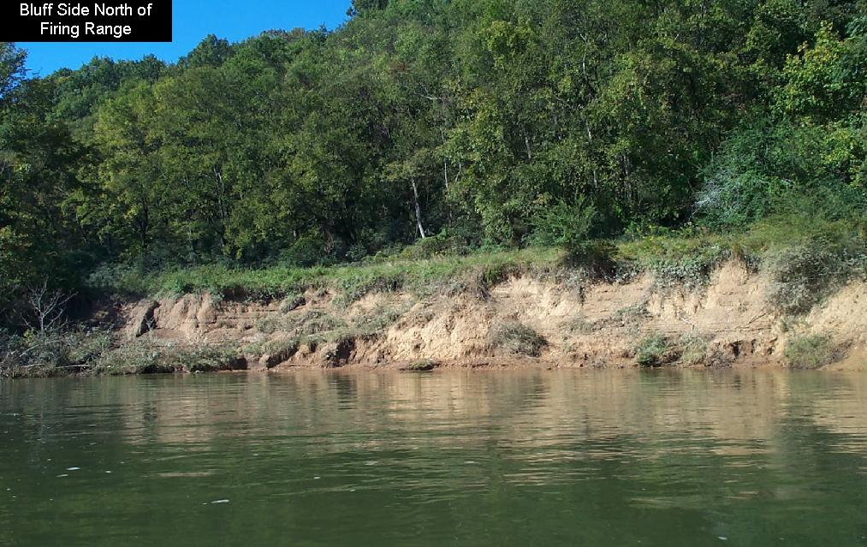
Functions of riparian buffer
Vegetation- corridor of specific width- adjacent to the banks of water bodies
Ecological health- temperature control, nitrogen filtering, bank stabilization
BMP - One of the best BMP for NPS control¹
Establishment - NRCS- CRP/CREP/EQIP, and EPA- Cost share through 319(h)
Photo : http://www.riparianinstitute.org
Photo: http://www.epa.gov
¹(Mayer et al., 2005)
Cooperative Extension Service
Notes:
Vegetation found in a corridor of specific width adjacent to the bank of water bodies. A vast amount of scientific literature has discussed about the mitigating affects of riparian buffer on surface water quality. Riparian buffers, as you may know, are very critical to the health of the streams.
The vegetation along water bodies provide ideal living conditions for diverse species. Trees surrounding the water provide shade and help maintain the temperature of water which is important to the survival of fish.
The root zone of trees in this corridor absorb nutrients (such as nitrogen and phosphorous) from subsurface flow, thus regulating the nutrient input to streams. Also, trees slow down runoff water which means they act as effective sediment traps.
Due to presence of trees surrounding the banks, erodibility of soil is considerably reduced. This results in stabilization of stream banks.

Slide 3
Riparian Buffer: Challenges and Opportunities
Financial
Social
Physical
Constraints
Identify where they are needed most, or where they can perform best
Effectiveness
Farming
Timber logging
Channelization
Dredging
Disturbances
Quantify vegetation composition in riparian buffer
Objective
Cooperative Extension Service
Notes:
In summary, due to its multiple roles, riparian buffers are critical in maintaining hydro-ecological services of a stream. However over many years, riparian forests have reduced due to natural causes, timber harvesting, stream channelization, etc. It is important to restore and/or maintain this important natural resource. One of the first step in this direction would be to get an idea where and how much riparian forest cover we already have… Our literature review suggests that this mapping of riparian buffer vegetation has not been systematically accomplished across many watersheds.

Slide 4
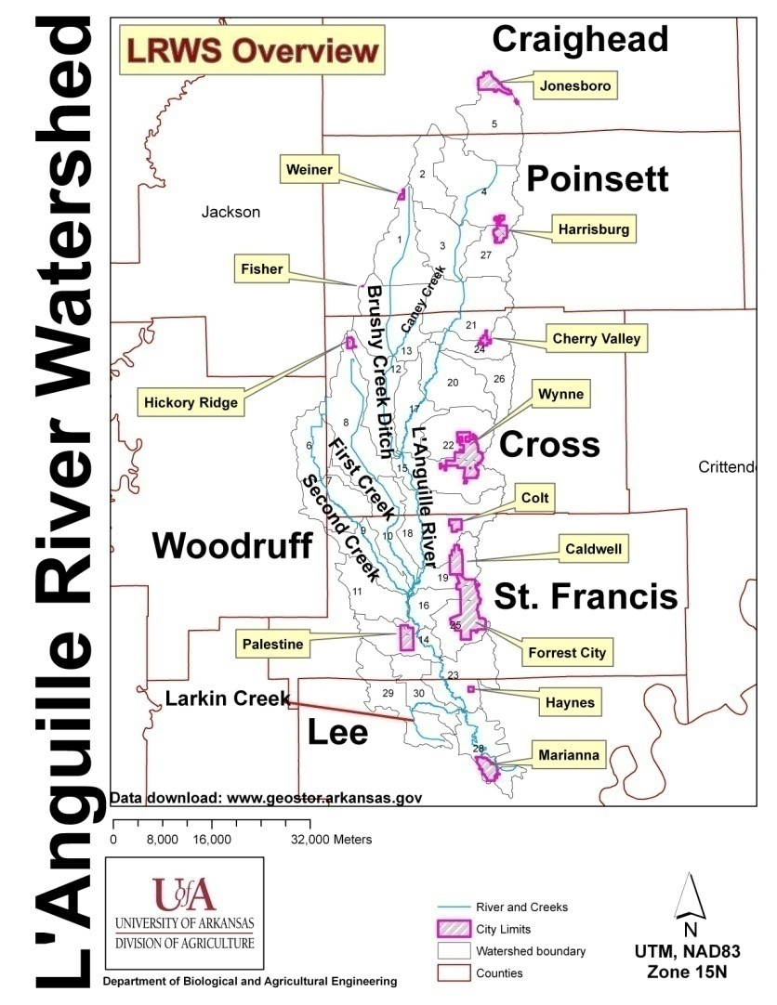
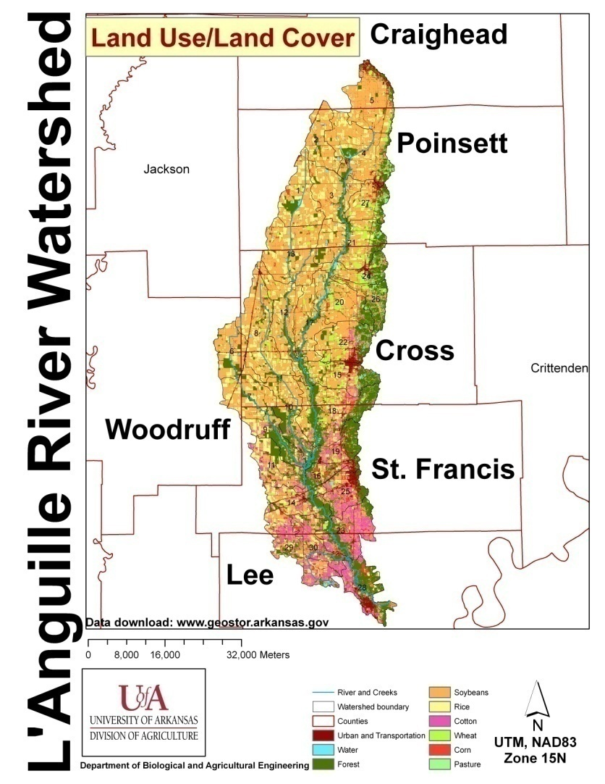
Study Area: L’Anguille River Watershed (LRWS)
Total Area under row crops (70%)
  soybean (42.3%),
  rice (14.9%),
Forest (21.2%),
Source of impairment
  Drainage of the lowland areas - ditching and channelization
  Silt loads carried into the streams from row crops
Study stream banks to determine sources for sedimentation (Audubon, 2005)
(Source: Center for Advanced Spatial Technologies (CAST), 2006)
Cooperative Extension Service
Notes:
The study area for the project was the Languille River Watershed located in Eastern Arkansas.

Slide 5
How wide should be the buffer..?
USDA-NRCS guidelines (Act 391 and 393):
Land Slope (%) | Riparian Forest Buffer, ft | Filter Strip minimum widths, ft |  |  | Total combined width, ft
 |  | Cropland | Pastures | Forest
0-1 | 35 | 10 | 20 | 25+0.25*25 | 60+6.25
1-3 | 35 | 15 | 20 | 50+0.25*25 | 85+12.5
3-8 | 35 | 20 | 50 | 50+0.25*25 | 85+12.5
8-20 | 35 | 25 | 100 | 70+0.25*25 | 105+17.5
20-40 | 35 | 25 | 100 | 90+0.25*25 | 125+22.5
Riparian buffers- largest of the minimum combined width “vegetation (trees and filter strip practices) lying within 45 m (147.5 ft) from the stream bank”
Cooperative Extension Service
Notes:
For the purpose of this analysis, we have defined riparian buffers based on the adjacent land slope. The table shows the width of the buffer required. For this project we used a 45 m buffer polygons for vegetation characterization.

Slide 6
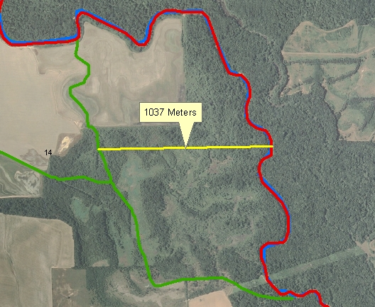
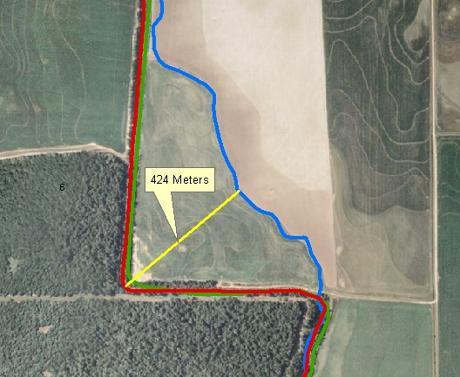
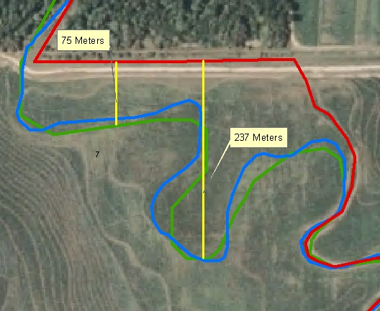
Input Data and Initial Effort
2006 natural color imagery
Stream layer- NHD Plus (ADEQ)
2006 LULC Image
Manually edit stream centerlines to ensure that they match location on natural color imagery
ADEQ
NHD Plus
Edited
Cooperative Extension Service
Notes:
Our work on this project started with unusual challenges. Our first approach was to create buffers around the stream centerlines downloaded from the high resolution National Hydrography Dataset (NHD) layer. We noticed that majority of the stream polylines where actually shifted away from the stream center.
(Note: Bushy creek = 48.42 km, First creek = 50.69 km, Larkin creek = 22.06 km, L’Anguille River = 175.66 km, and Second Creek = 56.32 km → Sum = 353.15 km )

Slide 7
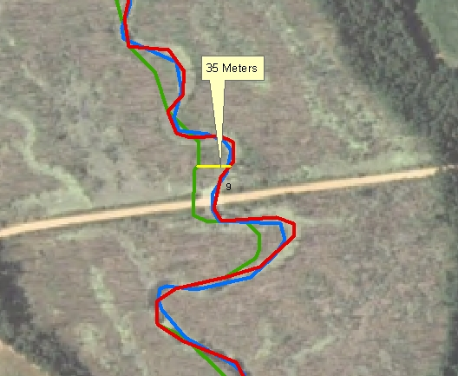
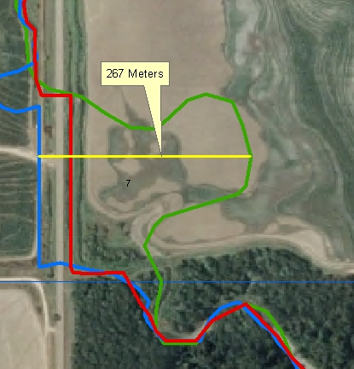
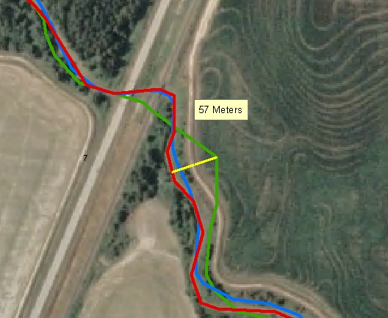
Riparian Buffer- Data Issues
Approx. 360 km (225 miles) of streams data was manually created
Scale used 1:700
ADEQ
NHD Plus
Edited
Cooperative Extension Service
Notes:
Hence we had to manually edit about 353 km of stream to ensure that they fell on the center of stream. To carry out this process we used a scale of 1:700 while panning across each of the four tributaries and Languille River and adjusting them as and when they started drifting away from the stream center. This was the most laborious part of this project.

Slide 8
Algorithm Development
Use edited stream centerline and natural color imagery obtained in Spring 2006 to delineate stream banks
Create buffers from stream banks
Find vegetation composition within the buffers
Leaf-off condition
Cooperative Extension Service
Notes:
For this project, the major ingredients were the stream centerline layer from previous work and 1-m resolution, 3 band natural color DOQQ imagery. The idea was to use these two, to search for stream banks. Subsequently buffer were created and intersect with LULC to find percentage forest cover.

Slide 9

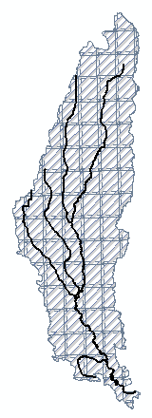
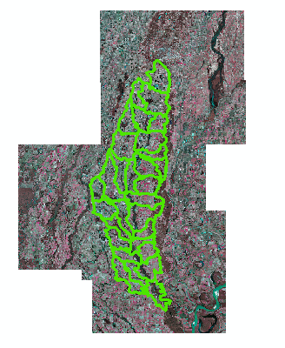
Searching for the right image
Challenge: Reading entire county 1-m DOQQ and extracting pixel values
Solution: Used 97 Quarter Quads (QQ) sequentially
Operation: Extent of each QQ used for searching image under sample points
Image search
Cooperative Extension Service
Notes:
The watershed runs across five counties. Each county DOQQ is about 473 MB and we ran into memory problems loading this entire county image grid for interpolation with stream center points
Hence we decided to use about 97 quarter quads each about 145 MB each encompassing the LRW boundary.
To automate the selection of QQ, we used the bounding box of each of these QQs to search for that image which fell under the stream center sample. To extract the pixel value, only the relevant QQ was read and data held until all the points on that image had been processed.

Slide 10
Finding Stream Banks
x
Identify perpendiculars to the stream
Extract pixel values along perpendiculars
Identify stream banks using edge detection concept
bi-normal
Stream centerline
y
Cooperative Extension Service
Notes:
Additionally 20 perpendicular pixels were also read. Through trial and error we noticed that when about 5 consecutive pixels have DN values below 50, we could safely say (with few erroneous points) that we had hit the stream bank. The first pixel identified in the 5 pixel series was labeled as the stream bank. We used this decision criteria to delineate streams. However, in some cases if this did not work for first 20 pixels, we used the stream boundary from the upstream sampled points. The stream point were then connected to create a line shapefile for creating buffer.

Slide 11
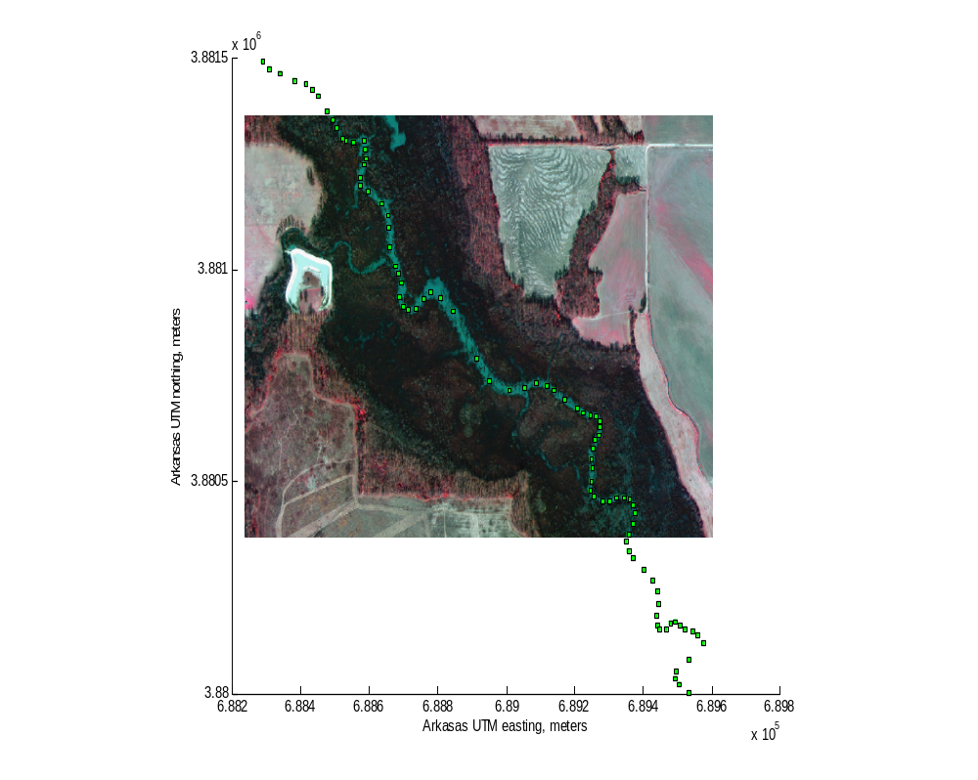
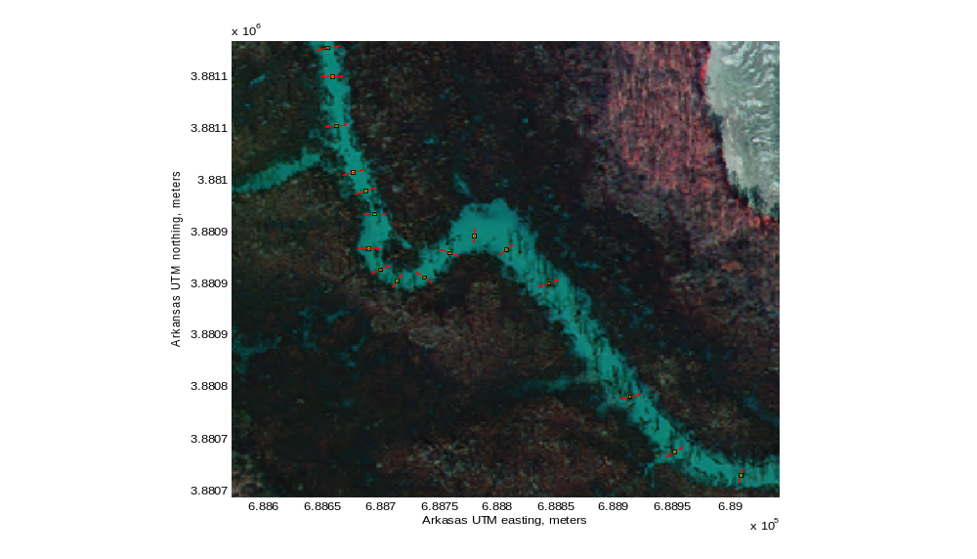
Results –Perpendiculars
sampled stream centerline
identified perpendiculars
Cooperative Extension Service

Slide 12
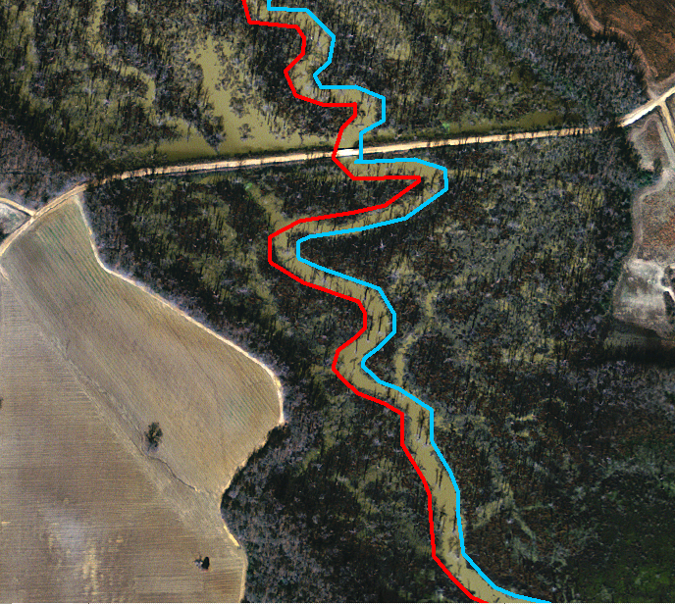
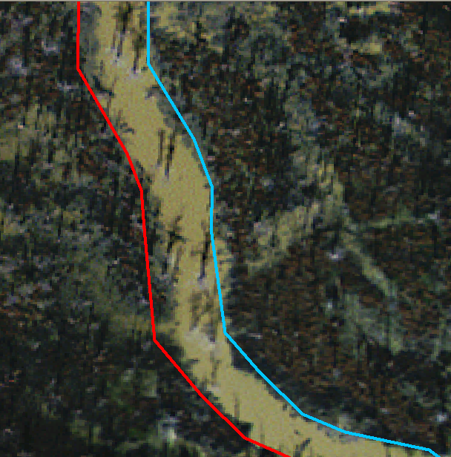
Results -Stream Boundary Delineation
Cooperative Extension Service

Slide 13
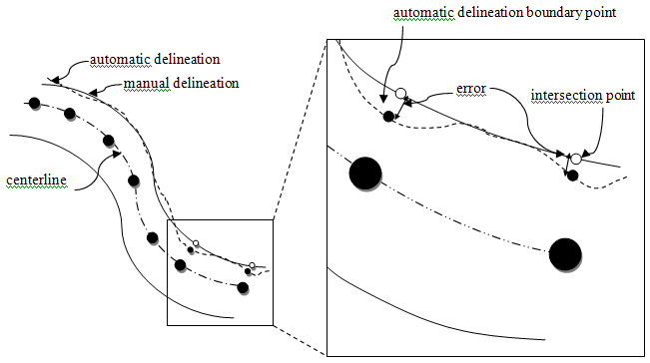
Error Analysis
How much error can we expect from this method?
Compare with manually delineated streams in GIS
Mean error of 2.55 m (RMSE 3.41 m)
Cooperative Extension Service

Slide 14
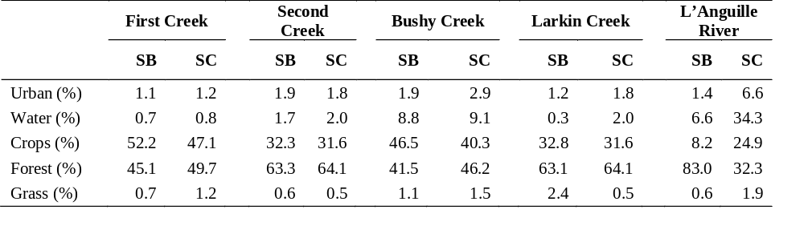
Results – Vegetation Composition
Stream Bank
Stream Centerline
Lower water pixels inventoried
Higher accuracy of riparian inventory
Cooperative Extension Service

Slide 15
Summary
Algorithm developed to delineate stream banks: mean error 2.55 m (RMSE 3.41 m)
Riparian inventory shows >32% cropland acreage adjacent to tributaries
Lower water pixels inventoried resulted in higher accuracy of riparian inventory
Cooperative Extension Service

Slide 16

Acknowledgements
Deano Traywick
Center for Advanced Spatial Technology (CAST), Univ. of Arkansas
Dr. Jackson Cothren, Univ. of Arkansas
Cooperative Extension Service

